Slide 1
Mechanisms for Paris Agreement implementation at the global level
G. Safonov, Director of the Center for Environmental Economics and Natural Resources of NRU «Higher School of Economics» PhD (Moscow)
Council on transition to "green" economy under the President of the Republic of Kazakhstan, Astana, 4th July 2016

Slide 2

Paris Agreement
Climate goal: Limiting warming to no more than «2⁰С»
Countries have set specific targets on emissions reduction. However, the overall commitments on INDC are likely to lead to 3⁰С and higher
The UN insists on «1,5⁰С» scenario. The reports are being prepared by countries, business, NGOs. It will inevitably revise the goals in the direction of tightening
Total on INDC
Needed goal -50%
By 2018, countries should provide a "road map” of objectives achievement ( Low-carbon development strategies)

Slide 3
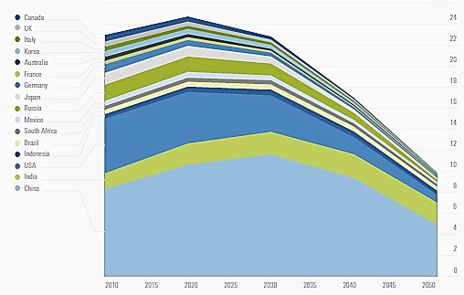

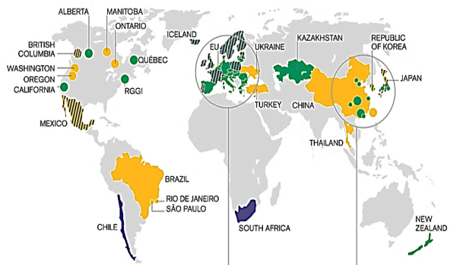
Mechanisms for PA implementation
Decarbonisation strategy of the economy
Development of global low-carbon strategies for economic development (DDPP, World in 2050…)
and sectoral strategies - energy, industry, transport, etc. (IEA, OECD...).
R&D investment in low-carbon technologies, refuse to finance the coal projects (World Bank, IFC, EBRD, ADB…)
The decarbonization portfolio of large investors (UNEP – Portfolio Decarbonization
Coalition, Government Pension Fund of Norway...)
Expansion / Globalization carbon markets, the introduction of a carbon price (taxes, etc.).
Mechanism of Sustainable Development (art. 3 PA):
  Based on the project mechanisms of the Kyoto Protocol
  Has not yet developed, requires the participation of the RK
  The Japanese government has been proposing the Joint Crediting Mechanism (JCM),
Carbon Markets of the World

Slide 4


Japan
In 2015, consumption of oil products by transport sector has decreased by 2,5%!
Overachieved the reduction commitments under the Kyoto Protocol by using the carbon market
Have an active policy of low-carbon development:
  targets for RES and NPP: 44% by 2030
  Forests accounting: absorbing capacity 65-80 million tons of СО2 per year
Developed the JCM:
  agreements with 16 countries,
  buys the 50-100 million tons of CO2 per year
Functioning market for CO2 emission quotas in the urban district of Tokyo:
  Overachieving the plan : emissions was reduced by 25% in 2015 instead of 2020
  The goal -30% by 2030
  Price of the quota reaches $ 100 per ton of CO2
There is a consideration of creating the national carbon market
Emissions in Japan, million tons of CO2-eq.
Tokyo’s carbon market: emissions reduction

Slide 5

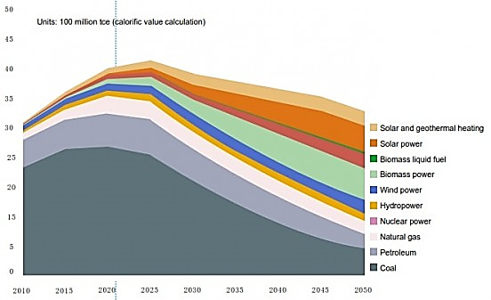
China
China ranked as world's largest emitter of carbon dioxide; emissions peak in 2020
- RES and coal:
  In 2015, the solar generation increased by 74%, wind by 34%!
  RES potential ~ 6000 GW
  More than 1000 coal mines will be closed this year (2016)
Seven Chinese provinces have carbon emissions trading projects. Price: 3,5-4 $/т СО2. China will launch a national carbon market in 2017 (the biggest in the world);
Country has extensive experience on implementation of "Kyoto" projects. 700 million tons of CO2 was sold.
China: 80% of RES scenario
Source: CNREC

Slide 6


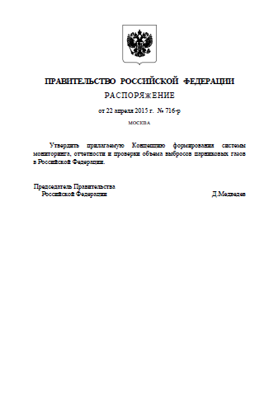
Russia
The PA was signed on April 22, 2016
A Draft Plan of implementation the PCA was sent to the Government of the Russian Federation
The goal -30% by 2030. The tightening is possible.
In 2017 г. – Carbon control concept ( the following will be considered: carbon market, carbon tax, standards, subsidies, project support...)
2016-2017:
  emissions reporting for companies
  emissions Inventory and Forecast by region and by sector
  supporting the project activity
  development of national strategy for low-carbon development

Slide 7

Australia
RES potential
Solar | 58 000 000 pJ
Wind | 10 000 pJ
Biomass | 1000 pJ
Hydro | 216 pJ
Geothermal | 441 000 pJ
Tidal | extra large
Existing decarbonization strategy
  82% emission reduction by 2050
  RES, NPP, CCS can ensure zero emissions
Carbon tax
  2012-2014 гг.
Quasi-ETS
  150 energy companies involved in the “market“ (Australian Carbon Credit Units)
Perspective CCS projects

Slide 8


Tasks for Kazakhstan
The strategy for low carbon development until 2030 and beyond is strongly needed.
Use Expo-2017 as a base for R&D and introduction of low-carbon technologies
ETS –promising mechanism have to be improved and linked to international carbon markets
Important : an absorption of CO2 by forests and pasture may reach 20-30 million tons of CO2 per year. It is more than the emissions from industry and transport. Thus, it is necessary to have a program for forest management.
Accumulated carbon million tones of CO2

Slide 9

Thank you for attention!
Contacts:
Georgy Safonov, gvsafonov@gmail.com

